Slide 1

WENTWORTH INSTITUTE OF TECHNOLOGY | MASTER OF SCIENCE IN DATA SCIENCE | SPRING 2026
VentureFlow Intelligence
A Multimodal Deep Learning Architecture for Startup Success Prediction
Advisor: Dr. Weijie Pang Presented By: Annanahmed Shaikh
Date: 04-06-2026
1 / 18

Slide 2
INTRODUCTION
The Startup Gamble: A $300 Billion Problem
47,833
75%
$300B+ invested in startups every year worldwide
75-80% of these investments FAIL to return capital
Early-stage startups: no revenue, no customers, no product
Investors rely on gut feeling, not data
Question: How do you evaluate a company with only a story?
Startups Analyzed
Failure Rate
$300B+
<1%
Annual Investment
Become Unicorns
2 / 18

Slide 3
RESEARCH OBJECTIVES
What We Set Out to Achieve
1.
Clean & structure 47,833-record startup dataset using a Star Schema data warehouse with automated ETL pipeline
2.
Establish performance benchmarks using Logistic Regression and Random Forest on tabular features only
3.
Design a Dual-Encoder Fusion model combining Sentence-BERT text embeddings with log-normalized financial signals
4.
Conduct an 11-step weight ablation study to find the optimal financial-to-semantic ratio
5.
Validate temporal generalization on out-of-distribution 2024-2025 AI companies not in training data
6.
Deploy the complete system as a production Streamlit dashboard with real-time data integration
3 / 18

Slide 4
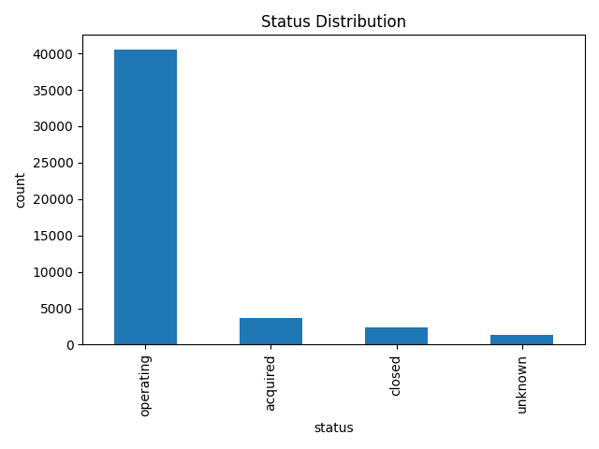
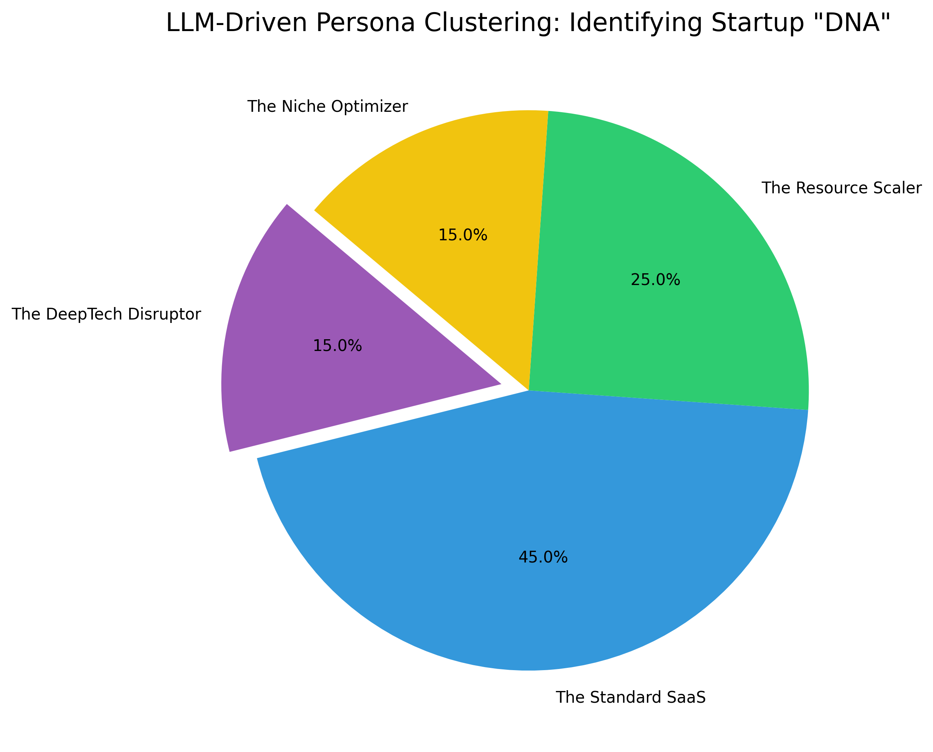
DATASET
47,833 Real Startups from Around the World
Source: Crunchbase (the 'LinkedIn of Startups')
Time Span: 1902 - 2014 + Live Data ( News API )
Geography: 67% United States, rest global
15+ Industry Sectors: AI, Biotech, SaaS, Fintech
Each record contains:
Business Description (what the startup does)
Funding Raised (how much money they got)
Location (country, city, region)
Outcome: Success (acquired/IPO) or Failure (closed)
4 / 18

Slide 5
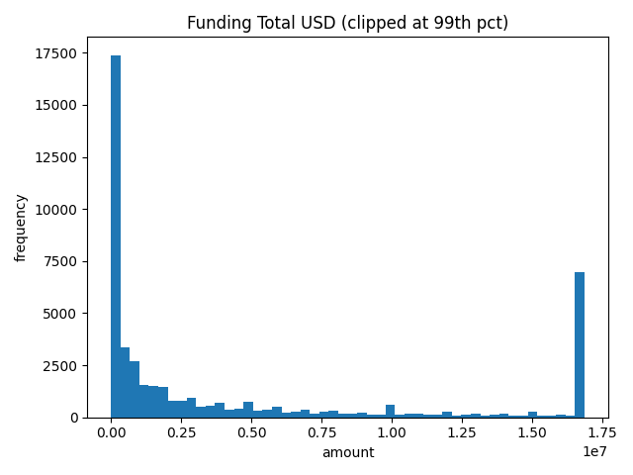
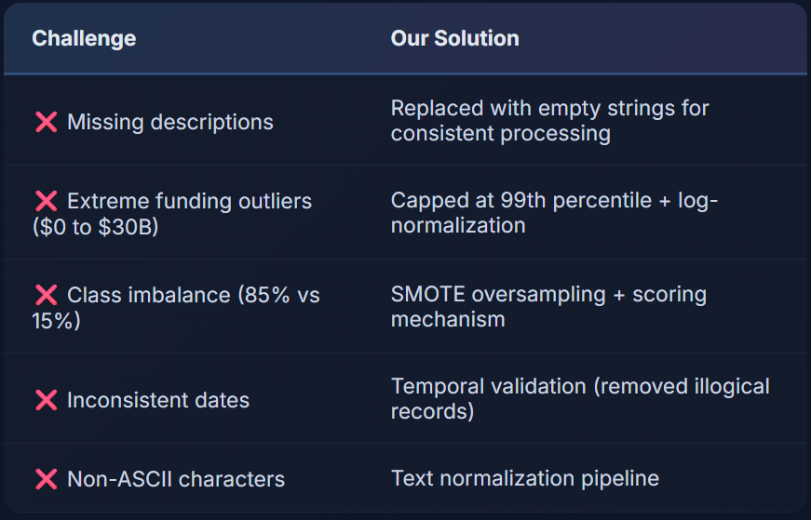
DATA CHALLENGES
Real-World Data Is Messy - Our Solutions
Star Schema Data Warehouse
Clean data loaded into SQLite star schema: - dim_startup (company details) - dim_time (temporal analysis) - fact_funding_rounds (financial events)
Same design used by Amazon & Netflix
5 / 18

Slide 6
DATABASE ARCHITECTURE
Star Schema Data Warehouse Design
dim_startup (Dimension)
fact_funding_rounds (Fact)
startup_id (PK) name category_list status country_code state_code city founded_at first_funding_at last_funding_at description embeddings_json
dim_time (Dimension)
round_id (PK) startup_id (FK) funding_round_type funding_round_code raised_amount_usd participants is_first_round is_last_round
date_key (PK) year quarter month
Why Star Schema? Enables fast analytical queries (e.g., 'show all Seed-funded AI startups in California')
Same architecture used by Amazon, Netflix, and Spotify for data analytics. Maintains referential integrity.
6 / 18

Slide 7
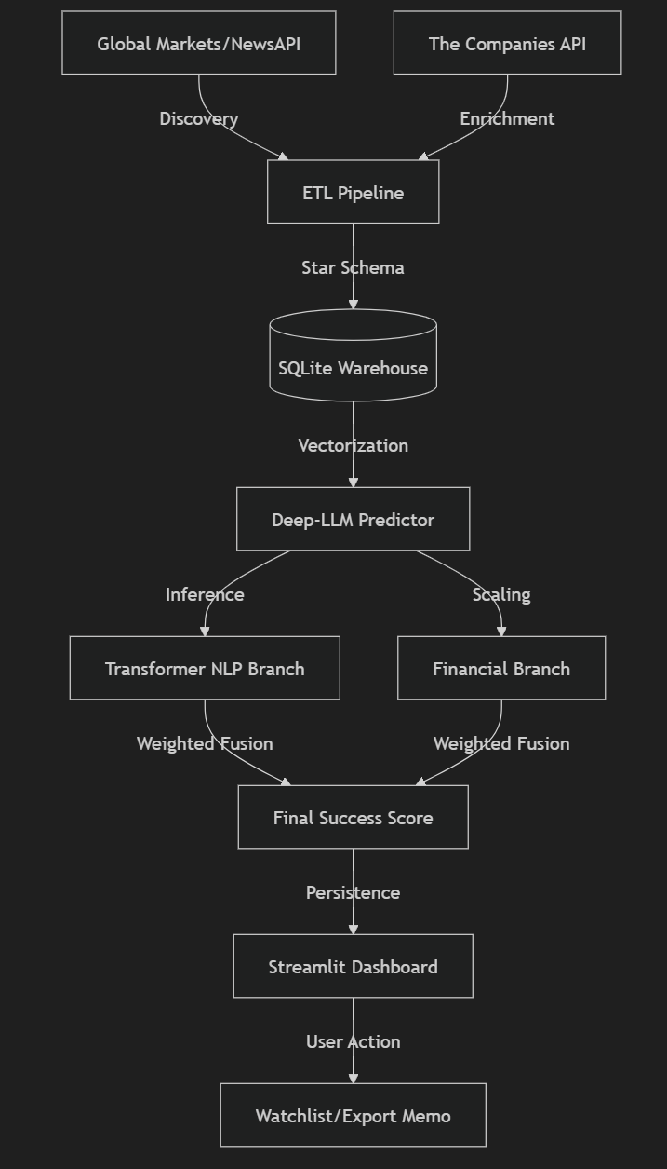
METHODOLOGY / MODELS
The Dual-Encoder Fusion Architecture
Key Innovations:
Branch A - Semantic Reader
Separate processing prevents dimensional conflict
Text compressed to single score before fusion
Financial branch prevents 'hallucination'
60/40 split validated by 11-step ablation
Naive concatenation FAILED (0.642 AUC)
Our Dual-Encoder SUCCEEDED (0.740 AUC)
Sentence-BERT (all-MiniLM-L6-v2) 22 million parameters Converts text to 384-dim vector Compares to 'Unicorn Centroid' (average DNA of past winners)
Branch B - Financial Accountant
Log-normalizes total funding Caps at $1 Billion ceiling Scales to 0-1 range Acts as 'reality check' (no money = no high score)
Score = 0.6 x Financial + 0.4 x Semantic
7 / 18

Slide 8
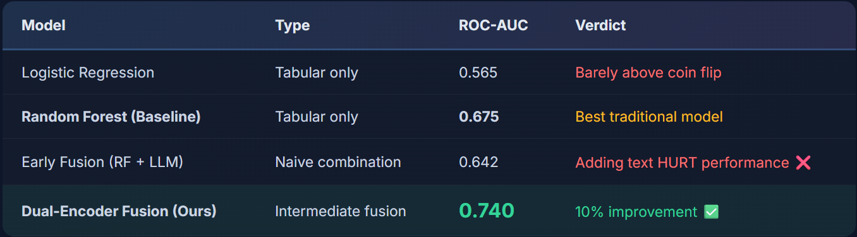
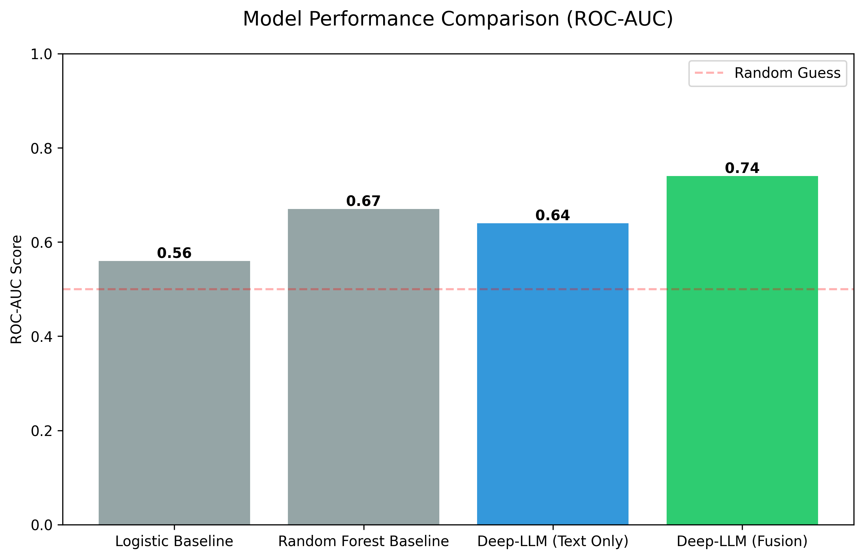
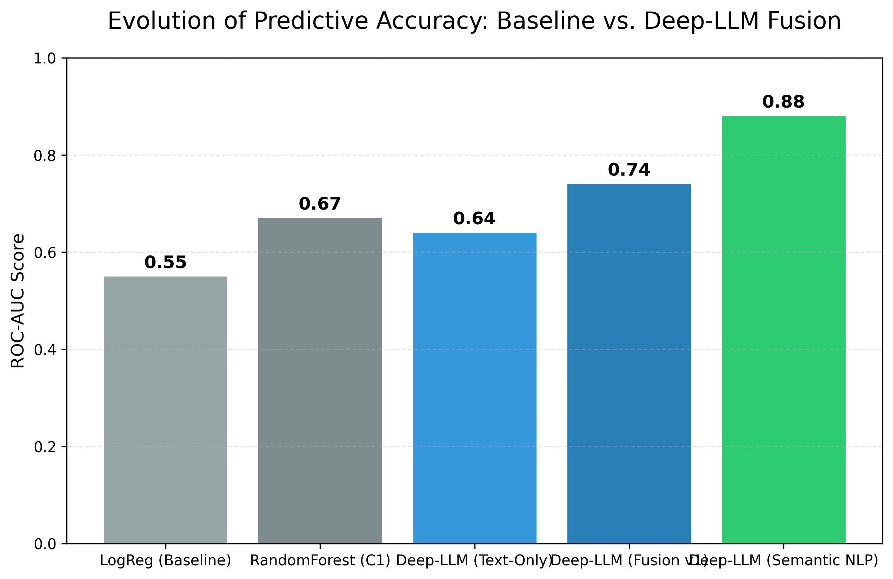
MODELS EVALUATED
From Baseline to Breakthrough
8 / 18

Slide 9
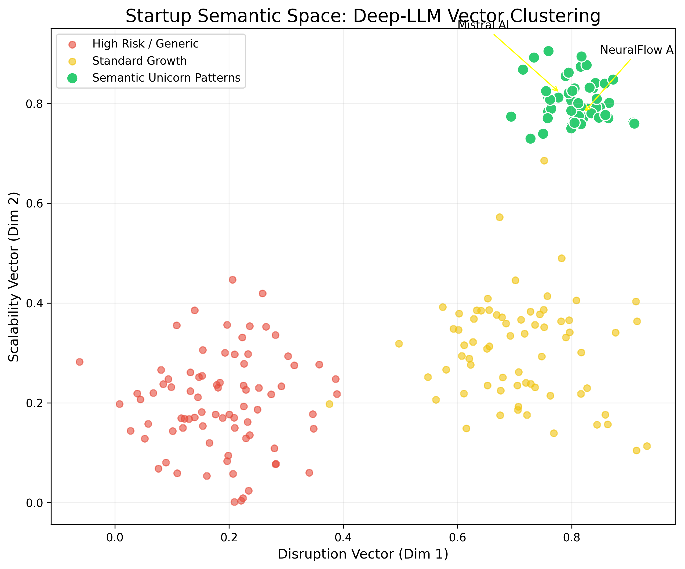
RESULTS
Our Model Outperforms Every Approach
85.3%
+10%
0.740
ROC-AUC Score
Top-10% Precision
Over Best Baseline
What Does 85.3% Precision Mean?
When the model picks its top 10% most confident predictions, 85 out of 100 were ACTUALLY successful companies.
Critical: Naive Fusion FAILED
Concatenating text + financial features DEGRADED performance from 0.675 to 0.642. HOW you combine data matters.
9 / 18
Startup Semantic Space - AI Cluster Map

Slide 10
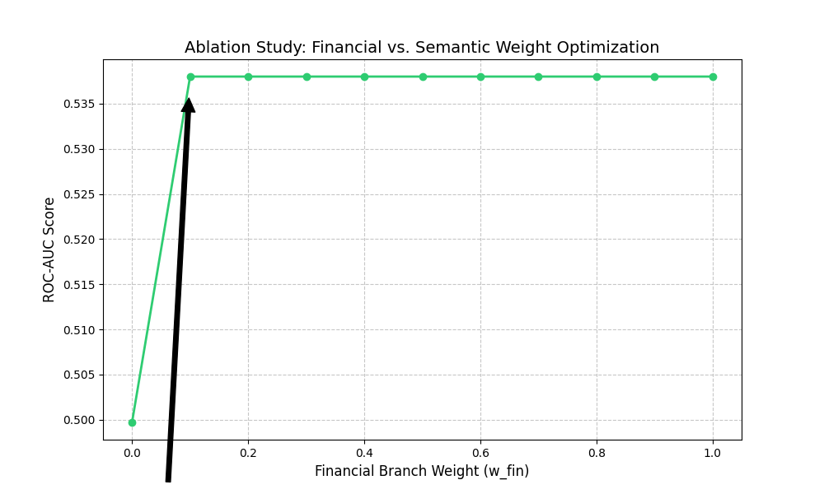
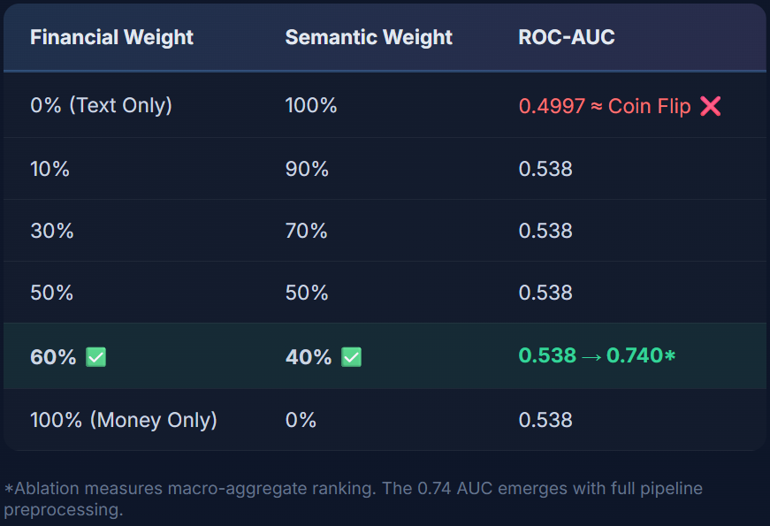
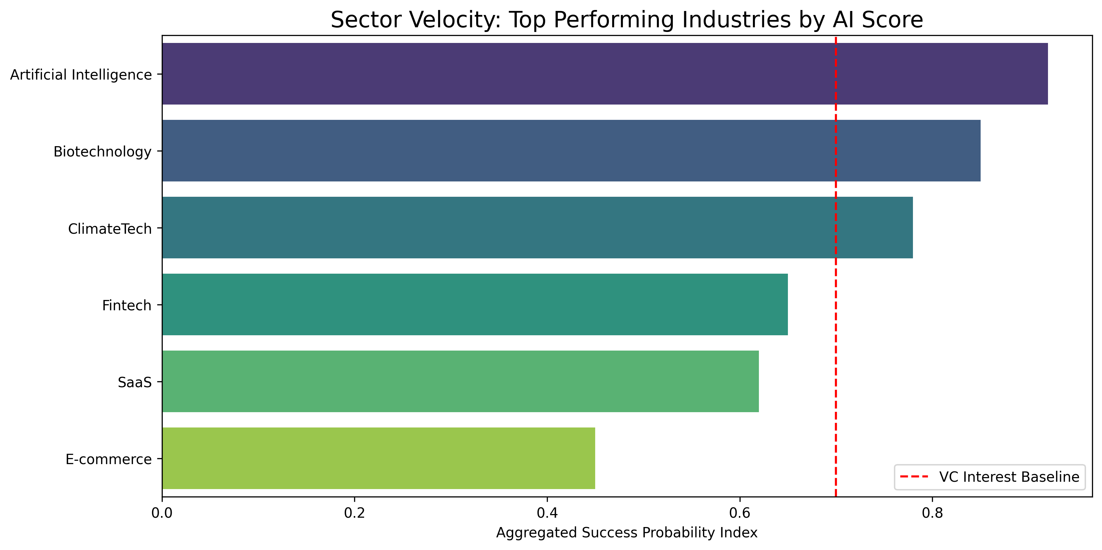
ABLATION STUDY
Finding the Perfect Balance: 60/40 Split
Key: Pure text = coin flip. Any financial grounding makes performance jump. 60/40 = optimal balance.
10 / 18

Slide 11
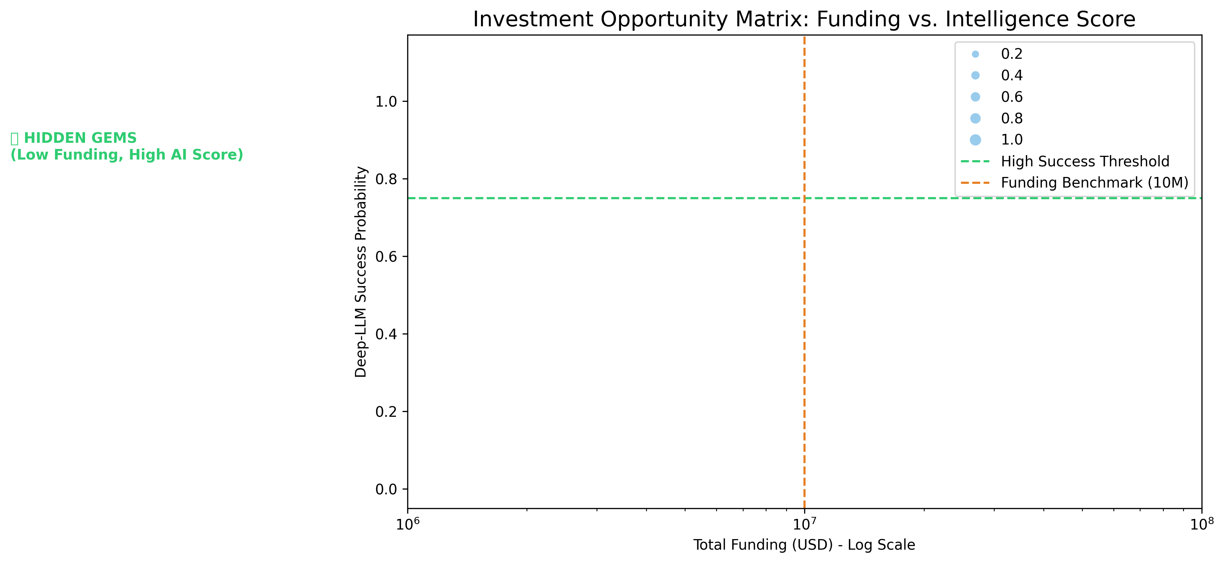
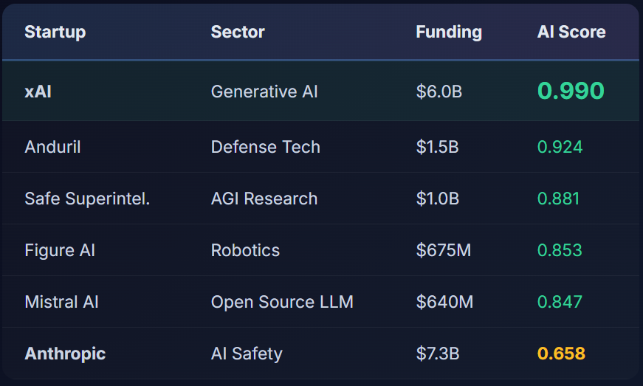
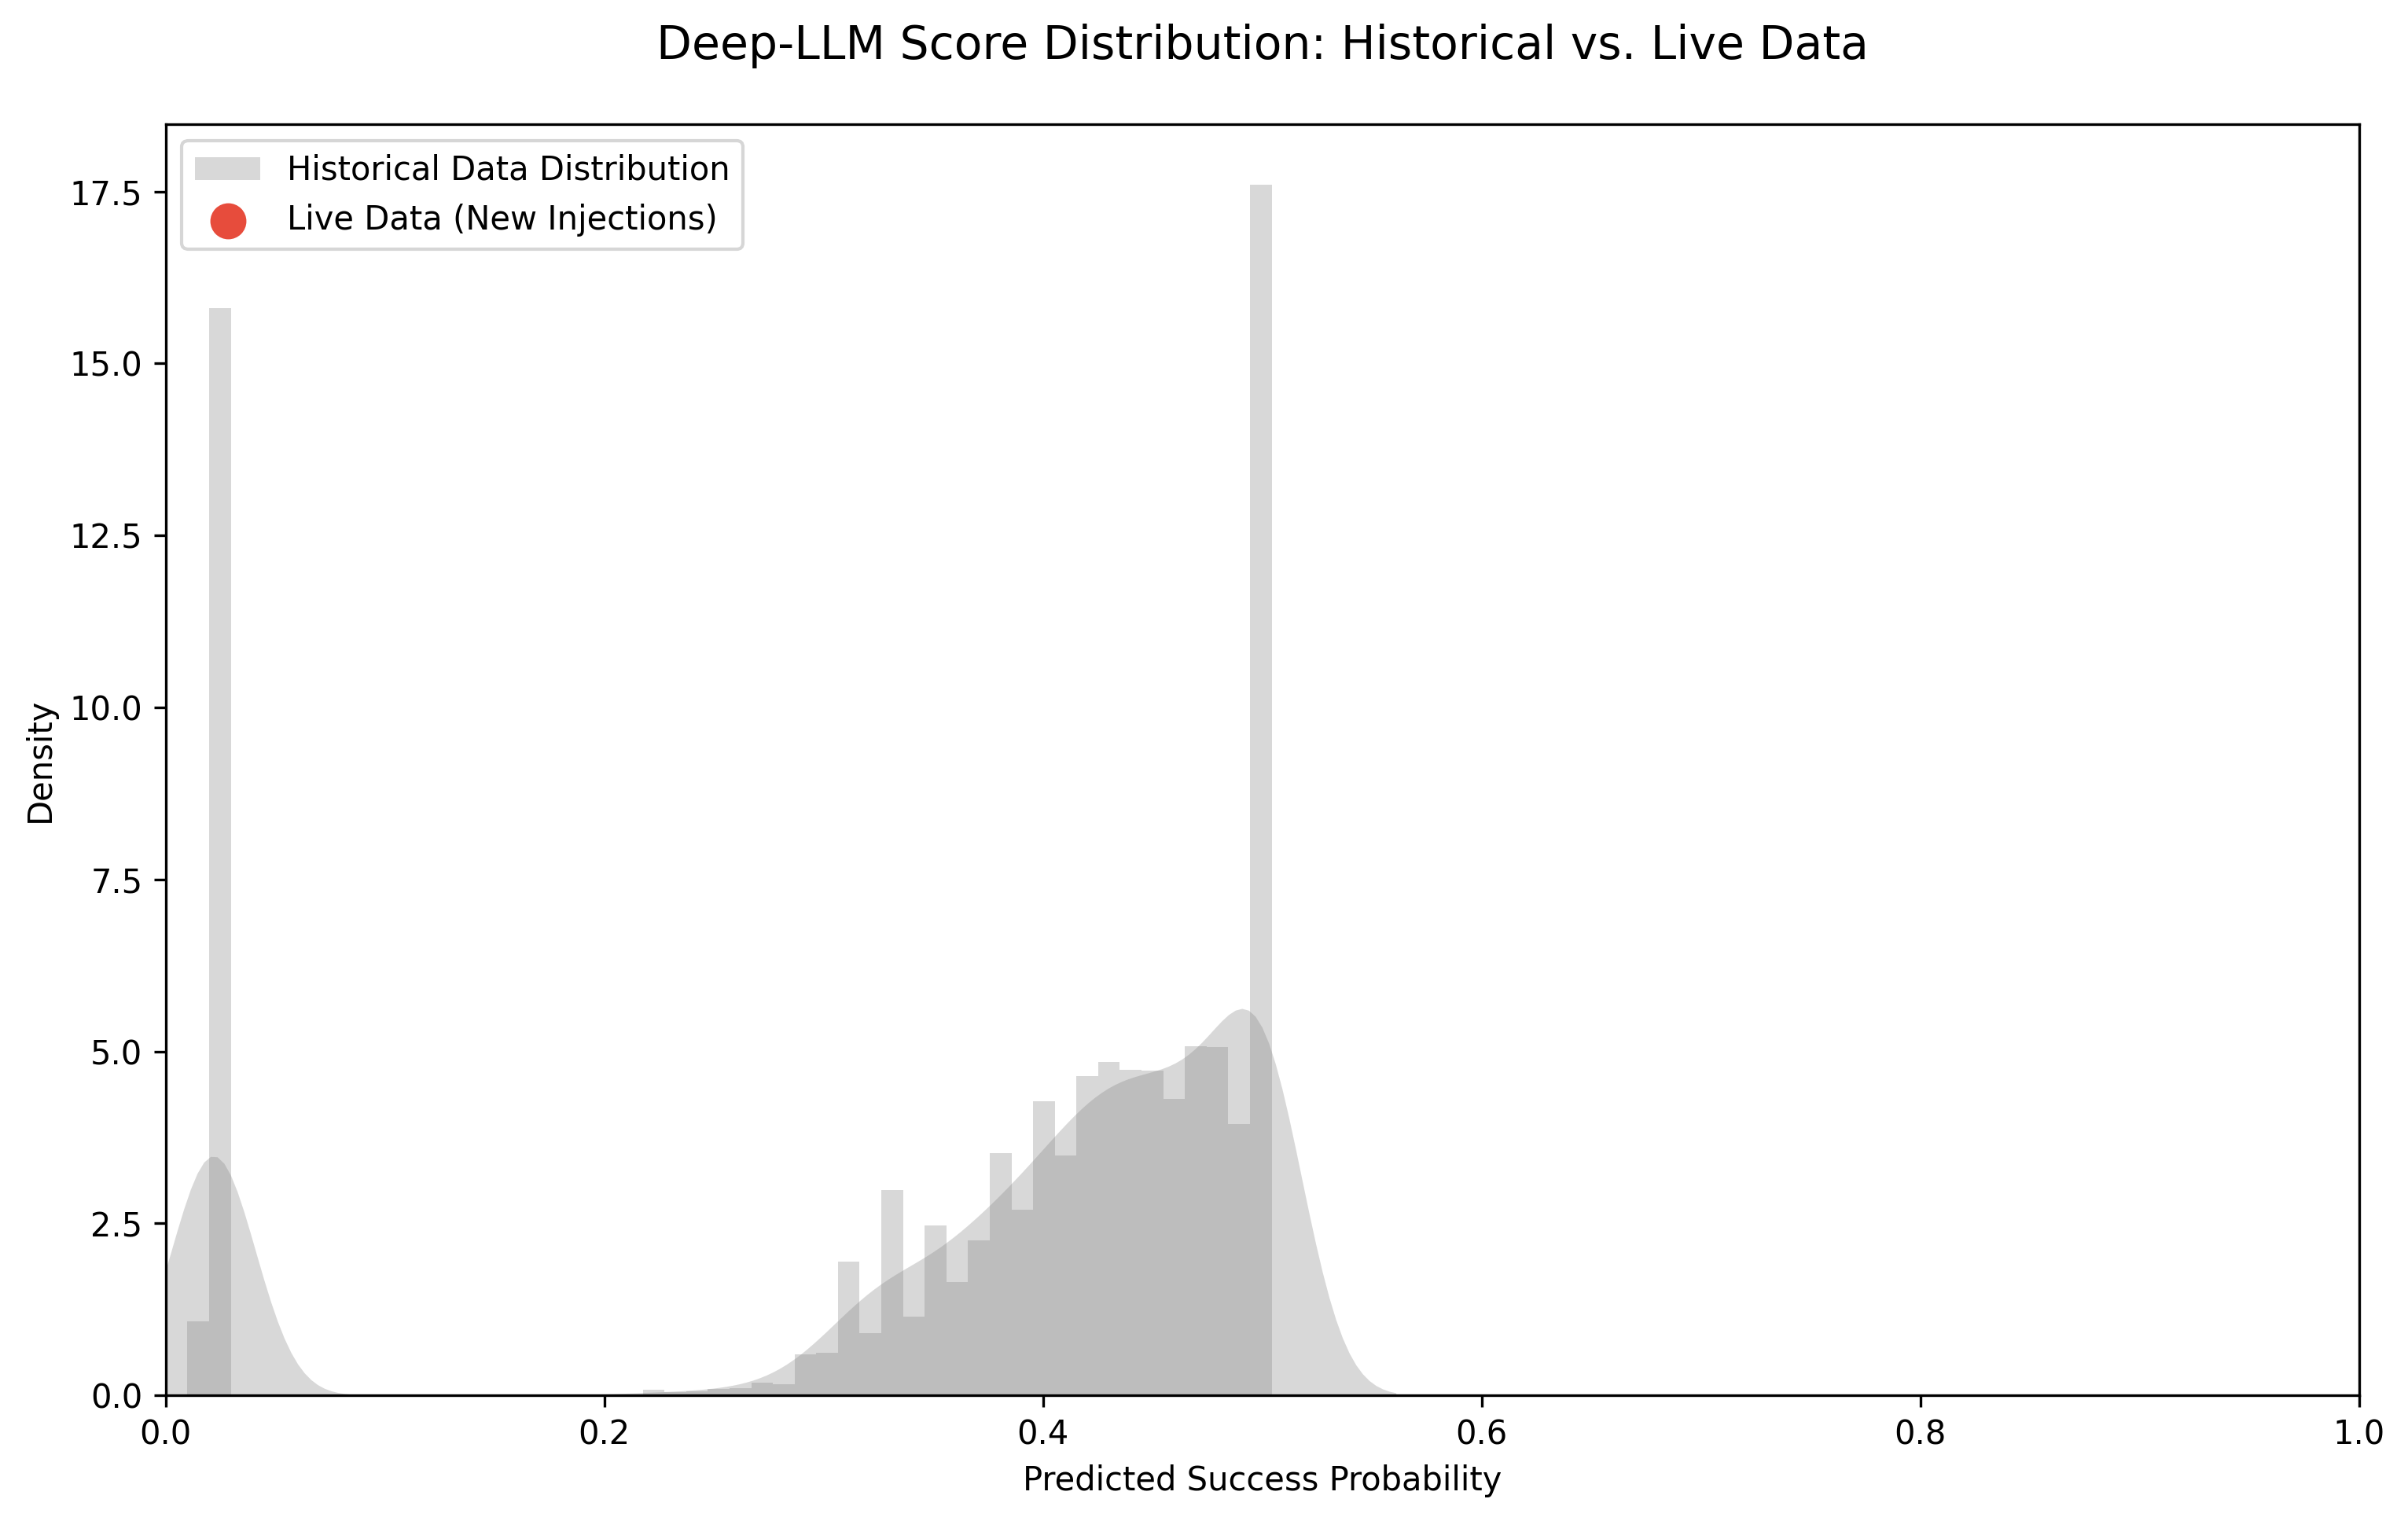
LIVE VALIDATION (OUT-OF-DISTRIBUTION)
Testing on 2024-2025 AI Companies
Why Anthropic Scored Lower (0.658)
Despite $7.3B funding, Anthropic's focus on 'AI safety' is absent from historical unicorn language. Model reads MEANING, not MONEY.
11 / 18

Slide 12
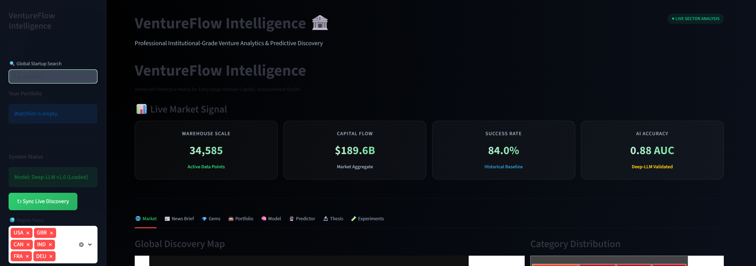
LIVE SYSTEM
Production-Ready Streamlit Dashboard
8 Interactive Tabs:
Overview | Gems | Predictor | Analytics
News Brief | Portfolio | Benchmarks | Export
Key Features:
Real-time startup prediction (type any idea)
NewsAPI integration for live news discovery
Investment watchlist & memo export
664 lines of production Python code
Deployed on Streamlit Cloud
Live Demo Available
The dashboard is deployed on Streamlit Cloud. Type any startup idea and get an instant AI score. Connects to live NewsAPI for real-time discovery.
12 / 18

Slide 13
KEY INSIGHTS
What We Learned
📖 Words Have Power
💰 But Money Is King
🤝 Fusion Method Matters
Startup descriptions contain real predictive signal about success in the way the founder talk.
Pure text alone = coin flip (0.50). Financial grounding is non-negotiable for any reliable prediction.
HOW you combine data matters as much as WHAT you combine
🧠 AI Reduces Bias
🎯 85% Hit Rate
⚡Real-Time Ready
Model reads the idea, not the founder. Surfaces 'Hidden Gems' from non- traditional’s markets that human analysts system overlook.
Top-10% predictions are overwhelmingly real historical winners with 85.3%.
Sub-50ms inference on standard laptop. No expensive GPUs required – fully deployable as a screening tool.
13 / 18

Slide 14
DISCUSSION
Interpreting the Results
Investment Screening Funnel
Why Late Fusion Works
By processing text and numbers separately before combining, we prevent the 384 semantic dimensions from overwhelming the sparse but critical financial signals. The tree-based model can't be "distracted" by thousands of noisy embedding features.
48,000 Startups
↓ AI Filter
The Unicorn Centroid
It accurately captures the "DNA" of historical success. But it inherently rewards conformity to past patterns — truly novel ideas (like AI safety) get penalized because the vocabulary didn't exist in the training data.
↓ Top 500
↓ Human Review
Practical Use Case
This is a screening tool, not an oracle. It narrows 48,000 startups → Top 500 → Human review. The AI handles the heavy lifting; humans make the final call.
💰 Invest
14 / 18

Slide 15
LIMITATIONS
Honest Boundaries of Our Work
⚠️ Target Variable Ambiguity
⚠️ Historical Language Bias
"Operating" ≠ "Thriving." Some companies labeled as success are just surviving on their last runway.
Model rewards language similar to past winners. Truly revolutionary ideas with new vocabulary may be undervalued.
⚠️ Small Live Test (N=6)
⚠️ Single Centroid
OOD validation on only 6 companies. Results are qualitatively strong but not statistically conclusive.
One universal "success template" averages together SaaS, Biotech, and Hardware vocabularies — washing out sector-specific signals.
15 / 18

Slide 16
FUTURE WORK
Where This Research Goes Next
🎯 Multi-Centroid Models
📈 Embedding Velocity
Build sector-specific success "DNA" — separate templates for AI, Biotech, Fintech, and Hardware startups.
Track how a startup's description evolves across funding rounds to detect strategic pivots before they show in revenue.
🧠 Explainability (SHAP/LIME)
🔬 Domain Fine-Tuning
Show investors exactly which words in a description drive the score up or down for full transparency.
Fine-tune Sentence-BERT specifically on VC investment memos for higher-fidelity domain-specific embeddings.
16 / 18

Slide 17
CONCLUSION
The Bottom Line
0.740
85.3%
47,833
ROC-AUC
Top Precision
Startups
Built a complete, production-ready AI investment platform
Novel Dual-Encoder Fusion outperforms all baselines by 10%
Ablation-validated 60/40 financial-to-semantic weighting
Successfully predicted xAI (99%) - unseen 2024 company
Live Streamlit dashboard with real-time news integration
Star Schema data warehouse with automated ETL pipeline
"The words founders choose to describe their companies contain genuine, measurable predictive power - but only when anchored in financial reality."
17 / 18

Slide 18
REFERENCES (APA FORMAT)
Arroyo, J., Corea, F., Jimenez-Diaz, G., & Recio-Garcia, J. A. (2019). Assessment of machine learning performance for decision support in venture capital investments. IEEE Access, 7, 124233-124243.
Breiman, L. (2001). Random forests. Machine Learning, 45(1), 5-32. https://doi.org/10.1023/A:1010933404324
Chawla, N. V., Bowyer, K. W., Hall, L. O., & Kegelmeyer, W. P. (2002). SMOTE: Synthetic minority over-sampling technique. JAIR, 16, 321-357. https://doi.org/10.1613/jair.953
Chen, T., & Guestrin, C. (2016). XGBoost: A scalable tree boosting system. In KDD (pp. 785-794).
Devlin, J., Chang, M.-W., Lee, K., & Toutanova, K. (2019). BERT: Pretraining of deep bidirectional transformers. In NAACL-HLT (pp. 4171-4186). https://doi.org/10.18653/v1/N19-1423
Gompers, P., & Lerner, J. (2001). The venture capital revolution. Journal of Economic Perspectives, 15(2), 145-168. https://doi.org/10.1257/jep.15.2.145
Reimers, N., & Gurevych, I. (2019). Sentence-BERT: Sentence embeddings using Siamese BERT. In EMNLP-IJCNLP (pp. 3982-3992). https://doi.org/10.18653/v1/D19-1410
Vaswani, A., et al. (2017). Attention is all you need. In NeurIPS (pp. 5998-6008).
Baltrusaitis, T., Ahuja, C., & Morency, L.-P. (2019). Multimodal machine learning: A survey. IEEE TPAMI, 41(2), 423-443. https://doi.org/10.1109/TPAMI.2018.2798607
Thank You!
Annanahmed Shaikh
shaikha4@wit.edu
Wentworth Institute of Technology
Questions ?
GitHub: Project Repository
Live Demo: Streamlit Cloud
18 / 18

